Slide 1
— Roidmi Intelligent Life —
Business & Cooperation
Mi Chain Enterprise

Slide 2
CATALOG
About Roidmi
Our Mission
Our Team
Our Strength
Global Strategy & Partner
Pruducts & Solutions
Achievements
Media
1
6
2
7
3
8
4
5

Slide 3
About Roidmi
To be MI Chain Enterprise
from 2015
Make driving more comfortable,more fun.
A young internet company focus on the intelligent vehicular products.
Investor:
MIUI & ShunWei Capital

Slide 4
About Roidmi
Owning
Products
From industry design to developing,manufacturing...
From UI interactive design to APP developing...
From market,sales to customer service...
8Dep；1R&D
5Items
Operation System
Striding Development
Staff Growth Rate/Year
126%
R&D Expenses Growth Rate/Year
86%
Roidmi Value Growth Rate/year
296%

Slide 5
About Roidmi
Automotive Intelligent Equipment
(Mobile station)
The number one in the market share of Chinese mainland in 2015；
Xiaomi Campaign（5th Phase）
Number one of the Backers QTY；Original campaign was 800% funded；
Market Share
Growth Rate
The first publish in JD Mall
(Intelligent hardware)
Sold out in the first day,over 4000 sets/hour；
32.6%
62.6%
Indiegogo Campaign (May 17th-July 2th 2016)
$232,189 USD total funds raised
2015% funded on July 2, 2016
Have got 3795 backers, many international media have reported；

Slide 6
Roidmi Timeline
Growth rate of month's sale is over 200% in 2015
Developing by 6 months,thousands of testing
Producing the complete telematics eco-chain
Roidmi 1th
Campaign in Xiaomi Website
Roidmi 2s
IGG campaign
Mijia Car Air
Purifier launch
Roidmi Magnetic phone
mount for car
New device launch on Indiegogo very soon
Roidmi
Established
1
2
3
4
5
6
Jan 2015
Oct 2015
May 2016
Dec 2016
March 2016
April 2016
Produce as Xiaomi brand and only supply for Xiaomi in China
Breaking all the records of Xiaomi Campaign

Slide 7
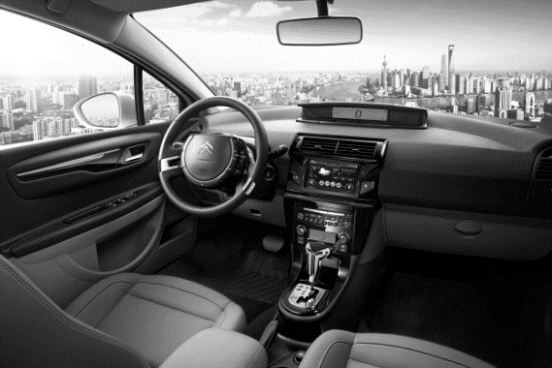
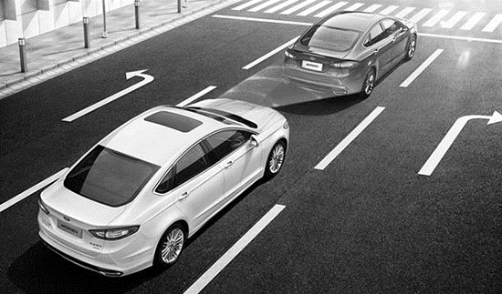
Our Mission
Make everybody enjoy the funny of driving!
Entertainment
Intelligent Health
Safty Driving
Connecting the car into internet by Roidmi, bring you the smart interconnect experience.
From the car environment to your body, we create a healthier environment for you by intelligent technology.
Tailored to a full range of intelligent monitoring for the safety of your driving.

Slide 8
Our Mission
Make everybody enjoy the fun of driving!
Intelligent
Health
Safty
Driving
Entertainment
Music Bluetooth Serise
（Hot sale）
（Coming soon）
（Coming soon）

Slide 9
Our Team
Professional focus, full of vitality, the courage to innovate!
We advocate innovation and fast Internet Culture;
We don't have a strict hierarchy, every employee is equal, every colleagues are the partnership;
We hate the long meetings and processes, we encourage the creative ideas in a relaxed working atmosphere;
We believe that the user is our driving force, we adhere to the product concept "make driving more comfortable, more funy."

Slide 10
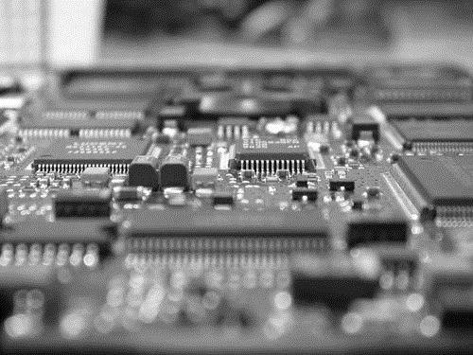
Our Team
Supply Chain Dep
Hardware Design Dep
Software R&D Dep
Marketing & Sales Dep
Charge of the supplier management, and the production tracking of many core generation factories.
Charge of the hardware R & D, industrial design, packaging design and product aesthetics.
Charge of the R&D of apple and Android client program , UI interface interaction design.
Charge of the brand operation, marketing activities, product sales and customer service.

Slide 11
Our Strength
Own 60+
technical patents
Super Famouse OEM factory
Independent R&D Test Base
Extremely strict quality control
1
2
3
Nanjing Yinghuada's customers: Apple, Xiaomi etc,famous as the foundry for IPOD and Xiaomi、
Red Mi series of mobile phones.
Hardware performance testing, new hardware and software compatibility testing, product technology certification and patent application and development.
First one to control the product quality to mobile phones'level, far ahead in this industry,the repair rate is less than 0.02% currently.

Slide 12
Global Strategy
Have layouted the whole Asia Pacific and the Far East
Since 2016,Roidmi has respectively saled the products to US, Europe countries,South Korea Russia and South America through the distributor and the advantages of proprietary channels, have gotten a leap
forward growth.
Aisa
target 40%
North America
target 30%
Europe
target 20%
Others
target 10%

Slide 13
Global Strategy
50%
40%
North America
& Europe
Asia &
Middle East
5%
South
America
5%
Roidmi’s global market layout in 2016
Follow the global layout of the Xiaomi and the operation of Roidmi overseas market, the future will focus on the layout of the North American and European markets.
Australia
New Zealand

Slide 14
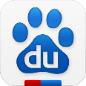
Strategic Partner
Platform interaction and openness:
Roidmi has always been maintaining adequate open of the APP access for the people who provide the contents of the human-car interactive class , continuously improve human vehicle interaction,interconnection.
Map navigation:
Baidu map
Speech recognition:
Baidu voice assistant
Third party service access:
Automobile insurance, fuel card,illegal query......
Roidmi car network APP ecological chain
Exclusive content and concentration:
In order to give users an innovative way of interactive, abundant interactive content, Roidmi always keep highly attention.
Mobile radio:
Dragonfly FM (exclusive)
Inter-Music:
MIUI music
QQ music
Netease cloud music
The third party acces Social interaction Hardware cooperation Exclusive content provider
Roidmi

Slide 15
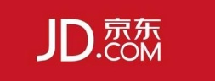
Channel Partners
Self-operated Channel
Roidmi completely control the main core sales channels.
Distributor Channel
Rapidly occupying all kinds of the consumer Internet platform through cooperation with the relevant category of dearlers.
Special and third party channels
Roidmi all new items'in crowd-funding and the first sales platform, and non network sales channels.

Slide 16
Products & Solutions
Products'name/model
Solutions
Advantages
Roidmi Bluetooth Car charger
1st Gen
Bluetooth 4.0,double USB charger
Mobile phone interconnection,Mobile device charging
Roidmi Music bluetooth car charger (2/2S) 2nd Gen
Bluetooth 4.2,double USB charging,MIC
Mobile phone interconnection,Mobile device charging,speech recognition,call
Xiaomi Car air purifier
Control the device with APP
Automotive odor and PM2.5,
CADR is 60m³/h
Roidmi B1 Anti-blue light glasses
Blocked blue light, 9-layer coating, modular design
Eyes protected when you use the computer, cell phone and TV.

Slide 17
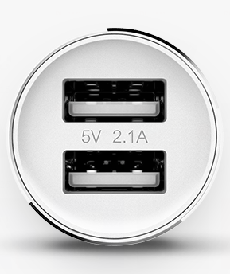
Products & Star Products
Bluetooth Car charger 1s and 2s
2 in 1 charger adapter

Slide 18
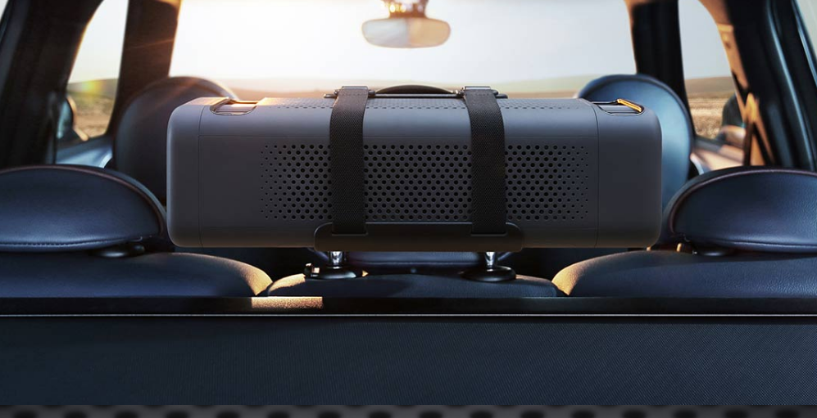
Products & New Products
Xiaomi Mijia Car Air Purifier (Only supply for Xiaomi Store from Dec 2016 )

Slide 19
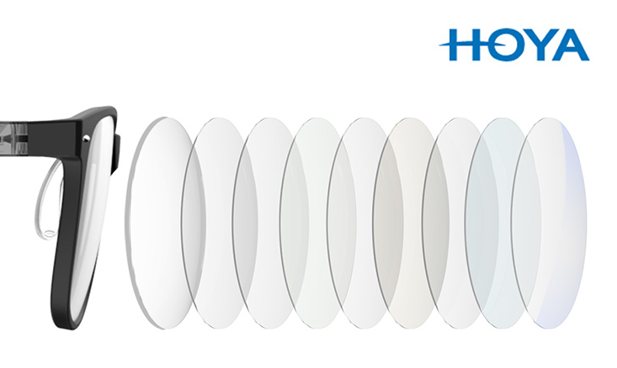
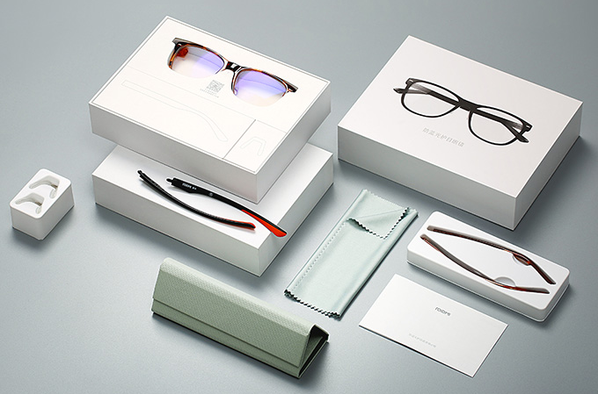
Products & New Products
Roidmi B1 Anti-blue light eyes protected glasses (Launched China market from 18th Jan 2017)

Slide 20
Achievements
90%
15%
50%
10%
Customer good reviews
Order conversion rate
Repeat purchase rate
Habits survey
Products'good reviews more than 90%,
Real time godd assess data collection:
The official website of
MIUI mall / mobile terminal
Jingdong Mall
T-mall
Leading in the peer under the order conversion rate.
And three times more than the average conversion rate of electronic business platform 5% times.
Old customer repeat purchase rate in T-mall is nearly 50%, specially for the core VIP customers.
According to Roidmi APP background data , about 10% users use blue charge every day listen to the internet audio content of the time over 60 minutes.

Slide 21
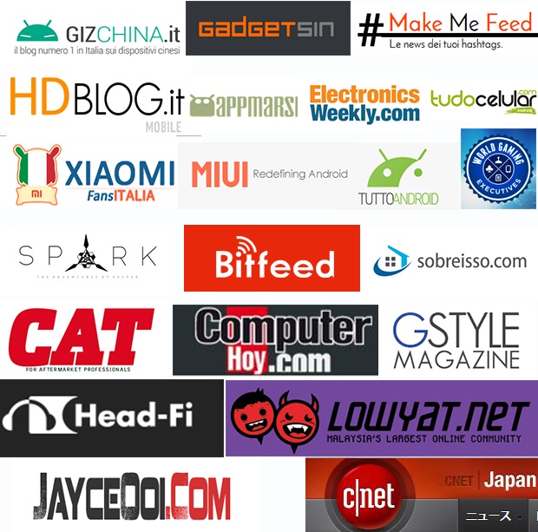
Media
Digital evaluation
media
Internet media
Video/car media

Slide 22
— Roidmi Intelligent Life —
THANK YOU!
Mi Chain Enterprise

